Slide 1

Grain Wise - Decision Tree Analysis

Slide 2

Rational Statement
A binary classification model to distinguish between Cammeo and Osmancik rice varieties using morphological features.
Data Processing:
Feature extraction from rice grain characteristics
Data standardization and train-test split (80-20)
Model Implementation:
Decision Tree Classifier
Performance evaluation using confusion matrix and classification metrics
Objectives:
Identify key morphological features for rice classification
Create an automated system for rice variety identification
Evaluate model accuracy and reliability

Slide 3
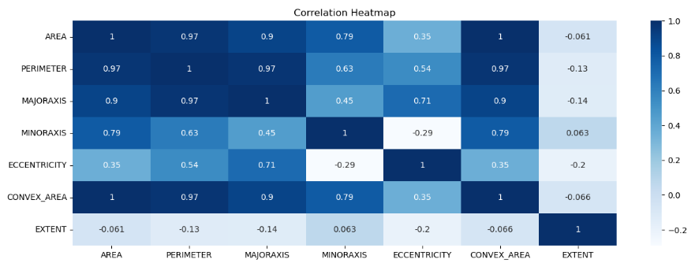
Correlation Heatmap
Size Features Show Strong Relationships:
AREA, PERIMETER, MAJORAXIS, and CONVEX_AREA are highly correlated (0.90-1.00)
Indicates that rice grains maintain consistent proportions as they scale in size
Suggests potential for feature reduction since these measurements track together
EXTENT is Independent:
Shows weak/negative correlations with all other features (-0.20 to 0.063)
Acts as a unique shape descriptor independent of grain size
Valuable for classification due to its distinct information contribution
These patterns help understand key grain characteristics and inform feature selection for the classification model.

Slide 4
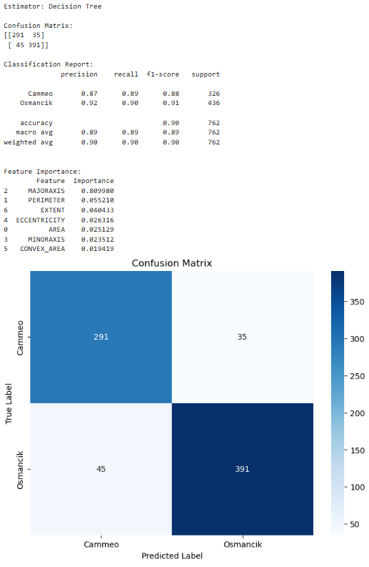
Confusion Matrix/ Classification Report
Summary Performance The model demonstrates excellent overall effectiveness with weighted averages of 0.89 across Precision, Recall, and F1-score for 762 total samples. The 90% accuracy indicates strong and reliable classification capabilities between rice varieties.
Class-Specific Analysis Breaking down by variety, Cammeo rice achieves solid metrics (0.87 Precision, 0.89 Recall, 0.88 F1-score) across 326 samples, while Osmancik rice performs marginally better (0.92 Precision, 0.88 Recall, 0.90 F1-score) with 436 samples. This suggests slightly higher precision in Osmancik identification.
Error Distribution The confusion matrix shows well-balanced performance with strong true positive predictions (291 Cammeo, 381 Osmancik) and minimal misclassifications (35 false positives, 45 false negatives). This even distribution of errors indicates an unbiased model that performs consistently across both rice varieties.

Slide 5
3 ways to improve the performance of Decision Tree Model
The first way to improve the model is by optimizing the tree parameters. This involves carefully setting the maximum depth of the tree to prevent it from growing too complex, adjusting the minimum samples required for splitting nodes, and implementing pruning techniques to remove unnecessary branches. Additionally, testing different split criteria like gini or entropy can help optimize how the tree makes its decisions.
The second improvement focuses on feature management. By utilizing the feature importance attribute of the Decision Tree, we can identify and focus on the strongest predictors while removing weaker features that don't contribute significantly to the model's decisions. This streamlines the tree's decision-making process and helps it focus only on the most relevant characteristics of the rice varieties.
The third enhancement involves properly handling the sample distribution in the model. This means setting appropriate class weights to manage uneven sample sizes between rice varieties, ensuring the minimum samples in leaf nodes are set correctly, and making sure the tree gives fair consideration to both rice types during classification.
These adjustments help create a more balanced and fair decision-making process.

